Slide 1
MakeItFit
A theoretician tries really hard to code in LaTeX.
Robbie Weber

Slide 2
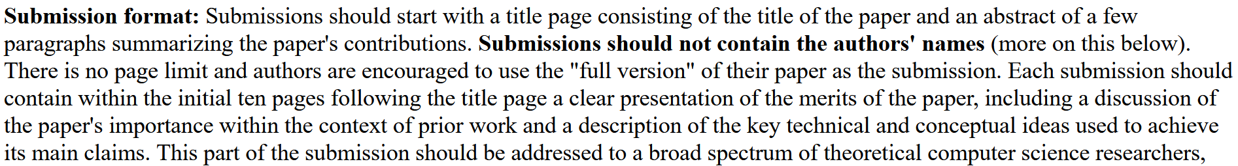
Theory: No page limits

Slide 3
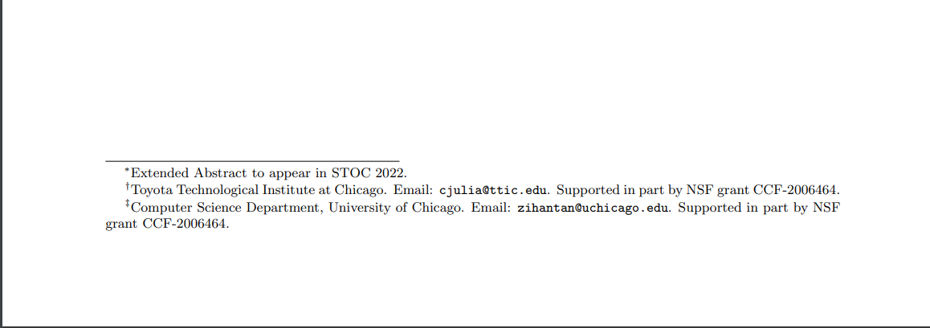
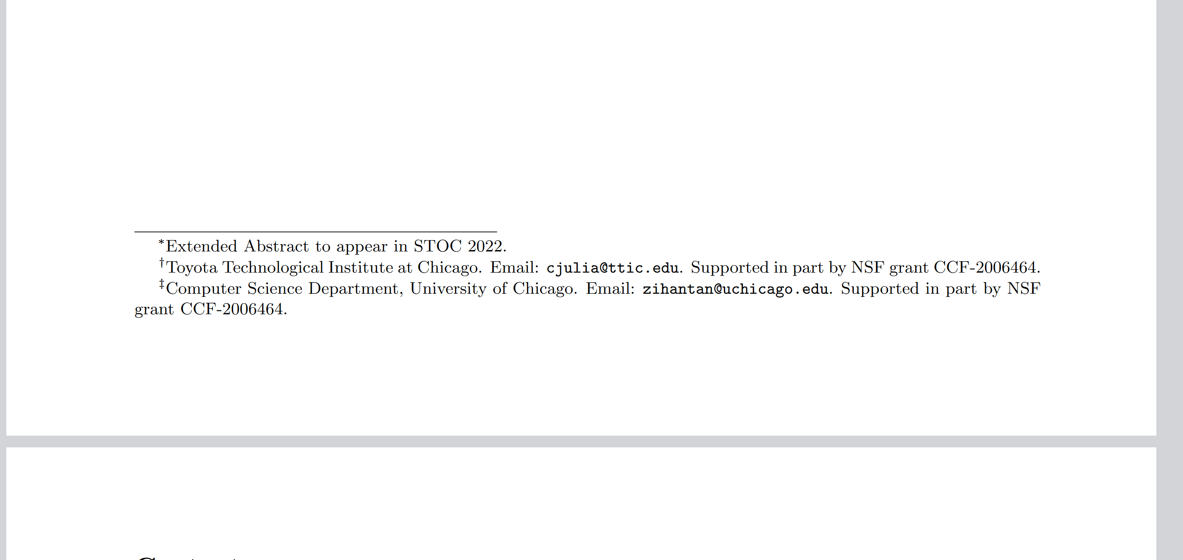
Sample Theory Paper

Slide 4
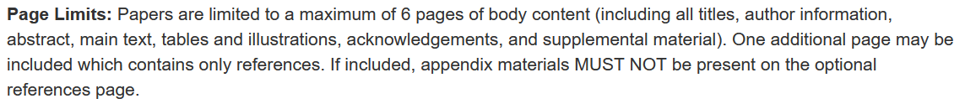
CS Ed: Strict Page Limits

Slide 5
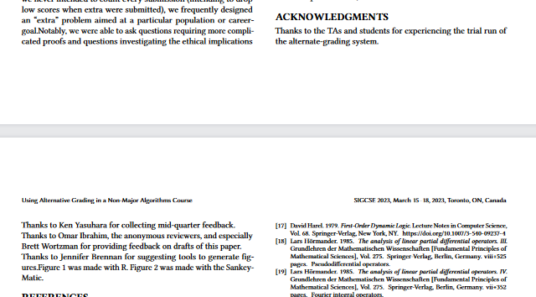
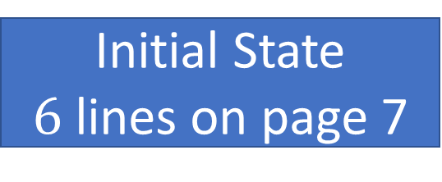

Initial State
$6$ lines on page 7

Slide 6
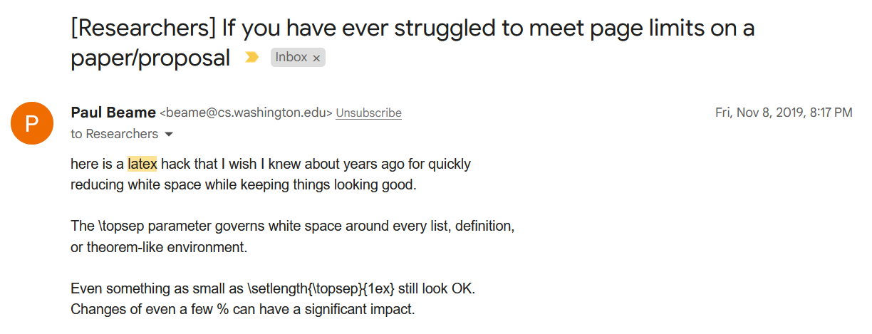
Prior Work

Slide 7
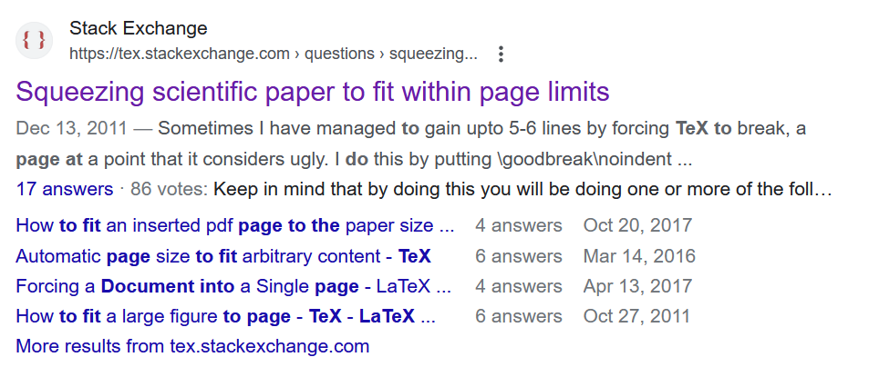
More Prior Work

Slide 8
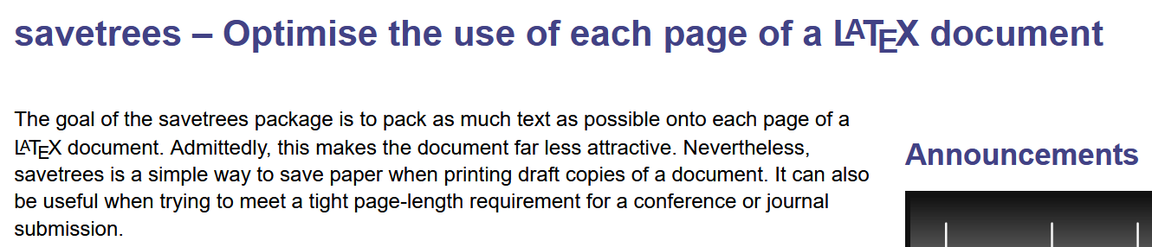
Even More Prior Work

Slide 9
Other Communities Who Hate Page Limits
High Schoolers

Slide 10
Other Communities Who Hate Page Limits
High Schoolers (pre-2023)

Slide 11
High School Strategies
Replace periods with larger periods.
Completely imperceptible. See? You didn’t notice. But it makes things just a bit longer.
Never use abbreviations.
This is the conference on research which is Potentially Computer Science.
We are at the University of Washington (not just UW)
Our strategy?
Reverse these strategies.

Slide 12
Initial State
$6$ lines on page 7

Slide 13
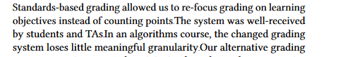
\tiny periods
smol.

Slide 14
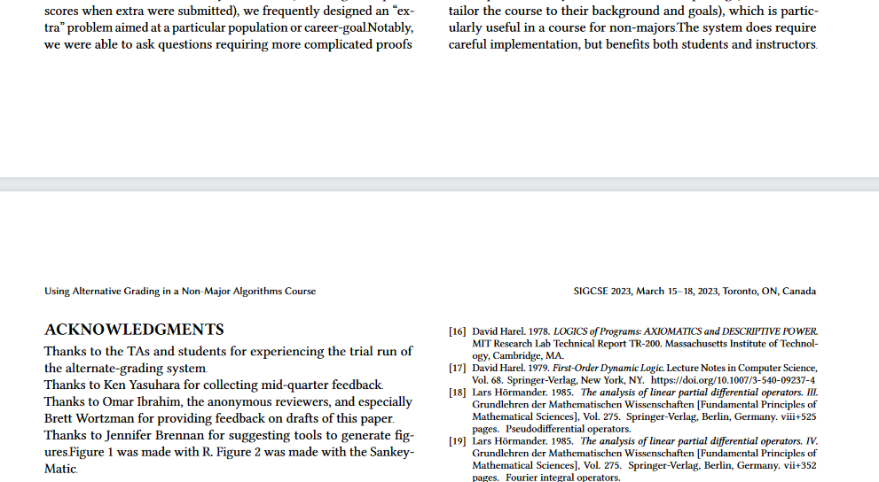
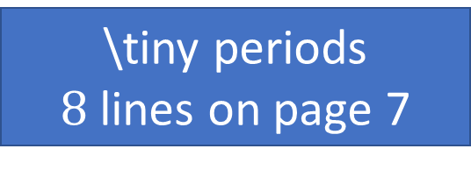
\tiny periods
$8$ lines on page 7

Slide 15
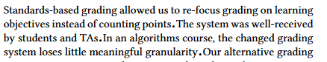
\huge periods
Emphatic.

Slide 16
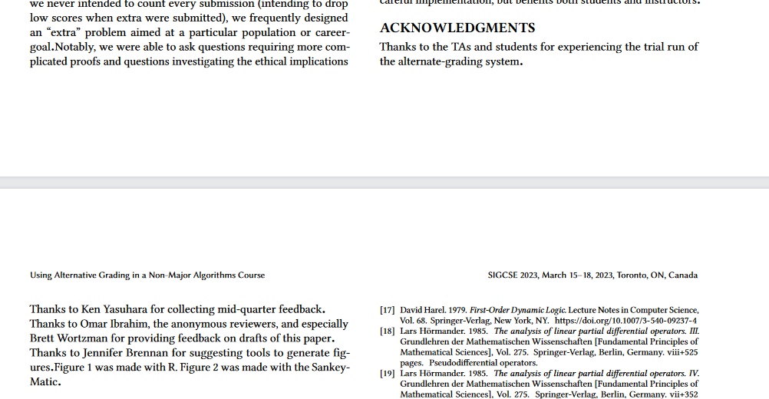
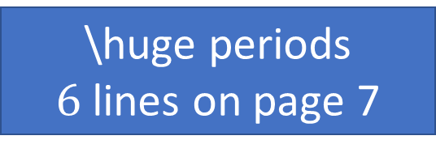
\huge periods
$6$ lines on page 7

Slide 17
Lessons?
Messing with fonts on periods also alters end-of-sentence spacing.
In a not useful way.

Slide 18
High School Strategies
Replace periods with larger periods.
Completely imperceptible. See? You didn’t notice. But it makes things just a bit longer.
Never use abbreviations.
This is the conference on research which is Potentially Computer Science.
We are at the University of Washington (not just UW)
Our strategy?
Reverse these strategies.

Slide 19
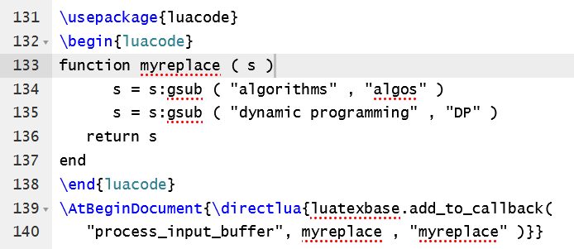

LuaLaTex, a superior find-and-replace
Notes:
https://tex.stackexchange.com/a/213990

Slide 20
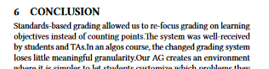
Hip!

Slide 21
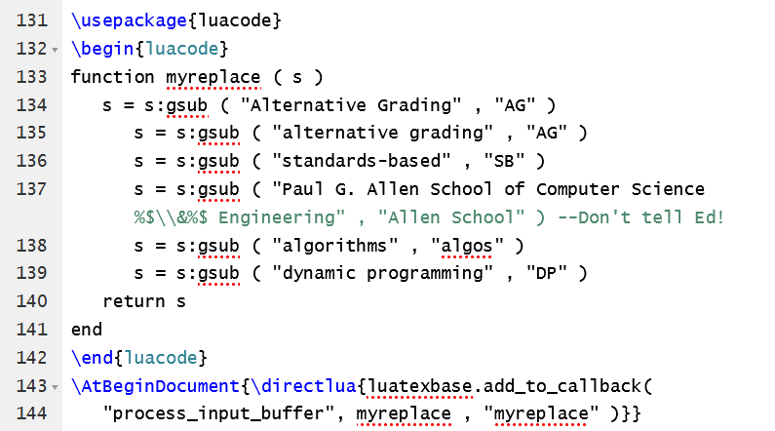
Still not short enough? Add more!

Slide 22
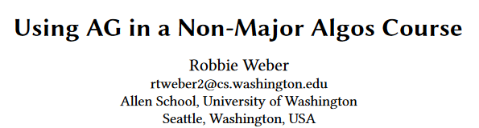
Changes Happen Everywhere

Slide 23
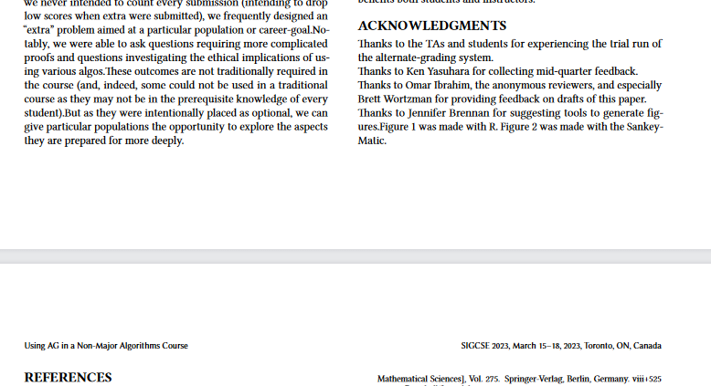
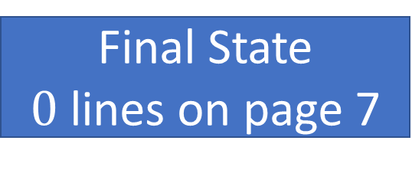
Final State
$0$ lines on page 7

Slide 24
What Have We Learned
Don’t let a theoretician write LaTeX code.
Periods are sacrosanct, do not alter their sizes or spacing.
Abbrevs. are the real best way to make things fit.

Slide 25
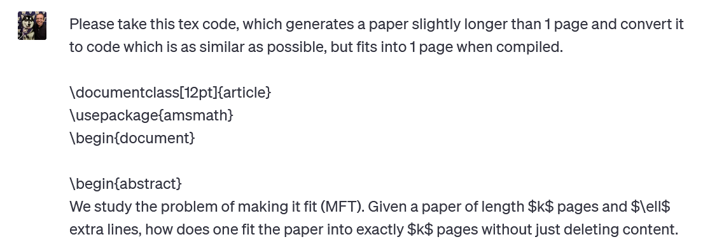
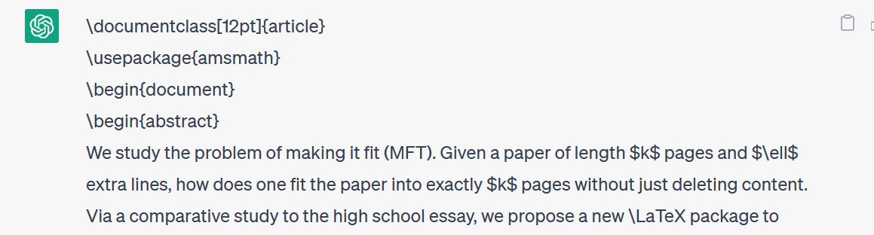
Future Work

